Slide 1
Enhancing Membership Growth
Google Data Analytics Case Study
By : David Satria Alamsyah
Last Modified : 18 January 2025

Slide 2
Agenda
Identify monthly trends in total ridership over a year
Looking at the differences between member and non-member riders in terms of daily intensity and duration of riding
Conclusion and recommendation
Appendix

Slide 3
Objective
Analyze monthly trends and differences between members and non-members to identify effective marketing strategies for enhancing membership growth.

Slide 4
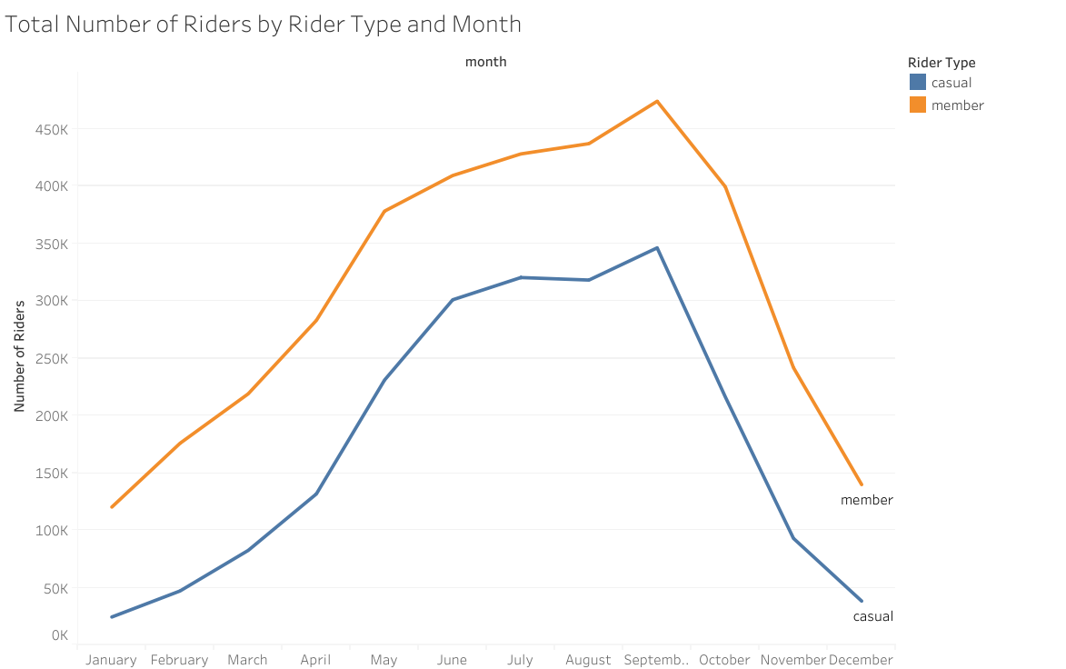
Monthly Trends
The data used spans from January to December 2024.
Members and non-members have similar trends
The highest point falls in September, equally among members and non-members.
Number of Riders
Month

Slide 5
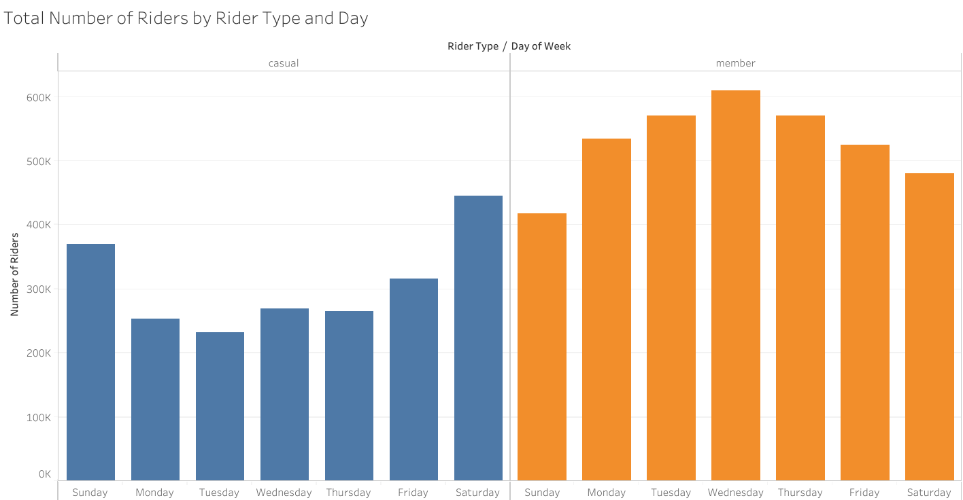
Differences by Day of the Week
Weekday
The total number of members exceeds that of non-members (casual riders).
On weekdays, member riders have higher numbers compared to holidays, while non-member riders show the opposite trend.
This suggests that the rider purchased the membership primarily for work purposes.
Weekday
Number of Riders
Day

Slide 6
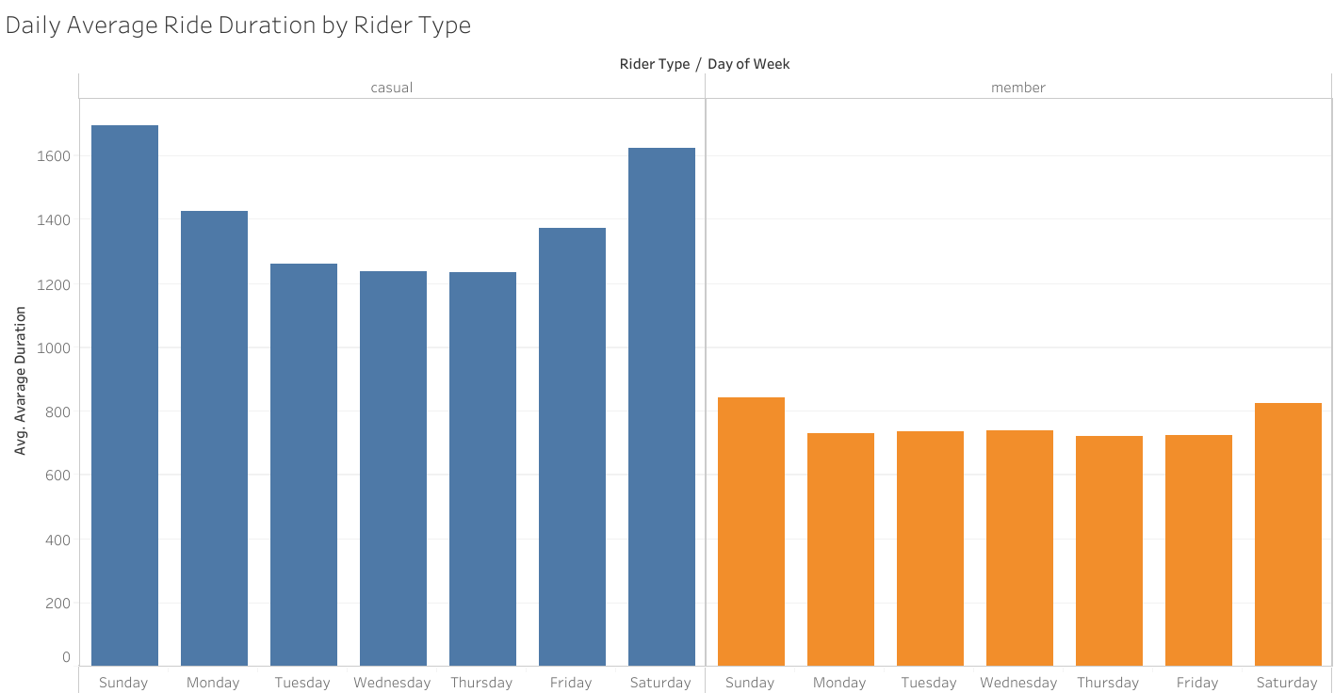
Differences by Average Trips Duration
The average total number of trips for non-member riders is higher than that of member riders.
This indicates that riders who purchase memberships typically have destinations nearby.
Average Trips Duration
Day

Slide 7
Conclusion and Recommendation
Marketing efforts should be focused in September, as it is the peak month for rider activity
Offering membership discounts or creating special weekday memberships due to the higher number of member riders during weekdays compared to weekends.
The increase in single-ride pass prices is attributed to non-member riders often traveling longer distances. This may also encourage them to opt for a membership instead of paying higher costs per ride.

Slide 8
Thanks

